Slide 1
Multi-task Neural Network for Simultaneous Classification-Regression with Repurposed Data
Muhammad Shoaib Manzoor

Slide 2
Introduction
Neural networks are created to Mimic the behaviours of human intelligence, and the capability of multitasking is known to be inefficient in humans as it decreases productivity by 40% and causes cognitive overload due to rapid switching between tasks, for this purpose we delegate the responsibility to Technology. But the question arises, is rapid switching between tasks better than simultaneous operation in Machine Learning.

Slide 3
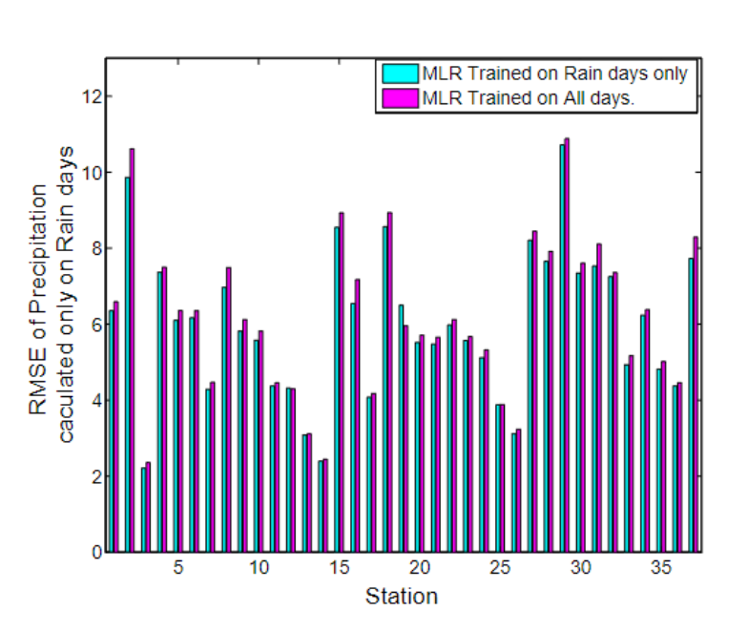
Background
Previously multi-task neural networks have been used to predict zero-inflated values (Rain & precipitation Dataset) using a 2-step method to first predict if the value is zero and then regression to estimate the value of non-zero time series values. (Iqbal et al., 2010)
Assumes non-linear relationship between predictors and response variables.
Focused on continuous data.

Slide 4
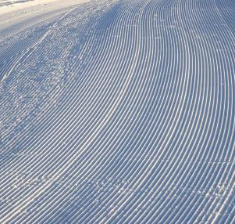
Dataset Employed
Please wait for Power BI screen.

Slide 5
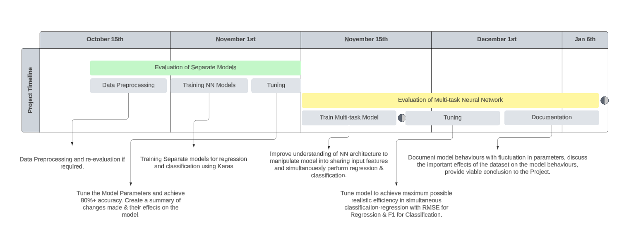
Gantt Chart of Project Span

Slide 6
Any Questions?
Thank you for Listening.

